Slide 1

Prerequisite Group Project
Project ID: 004
Peer Learning Group: 1.4
SOC 2 Type 2
TASK: Write a comprehensive report on the 5 Trust Service Criteria of Soc 2 Type 2 and its importance to organizations.
SIPHOKAZI MALOYI – CG/24/0039

Slide 2


INTRODUCTION
The digital age has transformed, trust is the new currency that keeps businesses thriving. As organizations increasingly rely on service providers to manage sensitive information and critical systems, building trust becomes essential. That's where the System and Organization Controls (SOC) 2 audit steps in—a beacon of assurance in an increasingly complex landscape.
The System and Organization Controls (SOC) 2 audit offers a standardized framework for service organizations to demonstrate their commitment to these core principles. This project will delve into the SOC 2 audit process, with a particular focus on the five Trust Service Criteria (TSC) of a SOC 2 Type 2 audit. By exploring these criteria, we will examine how they empower organizations to build trust with stakeholders and ensure the security and integrity of their data.

Slide 3


TRUST SERVICE CRITERIA (TSC) OF SOC 2 TYPE 2
TSC 3: Confidentiality
The Confidentiality criteria looks at the protection of confidential information against unauthorized disclosure or removal. This involves identification and classification of data and applying appropriate measures based on the classification. These measures may include data encryption procedures, access restrictions and contractual agreements that govern the handling of confidential data, ensuring it is protected from internal and external threats.
TSC 1: Security
The Security criteria is the foundation of the SOC 2 reports, emphasizing the need to implement preventative, detective and corrective controls to reduce the risks, such as unauthorized access, use, or change of information or systems. The focus of this TSC includes the entity level controls, information and communication, risk assessments and management, monitoring activities, control programs, logical and physical access, system operations, and change management.
TSC 2: Availability
The Availability criteria ensures data is available when needed for its intended use. This involves an assessment of network performance, site failover solutions, business continuity and disaster recovery procedures to ensure that uptime and system performance objectives are achieved. Thus, reducing the risk of service disruptions

Slide 4
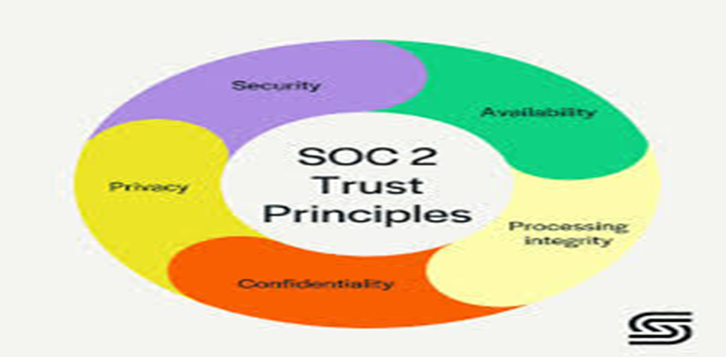
TRUST SERVICE CRITERIA (TSC) OF SOC 2 TYPE 2
TSC 4: Progress Integrity
This criteria ensures that ensures your systems are all working properly without producing any errors or incorrectly manipulating the data. Auditors look at the processes for data processing and quality assurance to verify that systems perform their intended functions in an unaltered manner and that errors are identified and corrected promptly.
TSC 5: Privacy
This TSC checks if you protect Personally Identifiable Information (PII) from breaches and unauthorized access. It does so by implementing rigorous access controls, two-factor authentication, and encryption. This measures assist in preserving information privacy by doing everything from notifying pertinent parties of privacy practices to updating and immediately disclosing any changes in how personal information is used. Privacy is, however, different from Confidentiality in that it applies to only personal information, whereas Confidentiality applies to various types of sensitive information.

Slide 5

IMPORTANCE AND REFERENCES
IMPORTANCES OF THE 5 TRUST CRITERIA TO ORGANIZATIONS
1. Reputation and Credibility: Businesses that adhere to these trust criteria show their commitment to ethics and ethical practices, data security/protection, and customer privacy.
2. Stronger Relationships: These trust criteria will help foster positive and collaborative relationships with stakeholders.
3. Reduced Risks: Adherence to these trust criteria helps manage risks associated with data breaches, security lapses, or non-compliance with regulations especially with the security part of the criteria.
4. Improved Decision-Making: When stakeholders trust the data and information they receive, after seeing these trust criteria implemented, businesses can make more informed decisions.
5. Regulatory Compliance: Adherence to these trust criteria usually aligns with industry regulations and data privacy laws.
6. For the security criteria, It not only sets overarching security standards for your company, but also overlaps with the others: setting security controls for availability, confidentiality, privacy, and processing.
REFERENCES
AICPA (American Institute of CPAs). (2017). SOC 2® Reporting on an Examination of Controls at a Service Organization Relevant to Security, Availability, Processing Integrity, Confidentiality, or Privacy.
AssuranceLab. (2024, February 22). SOC 2: The 5 Trust Services Categories. SOC 2: The 5 Trust Services Categories. https://www.assurancelab.cpa/resources/trust-services-principles
Colby. (2023). Trust Services Criteria (TSCs) for SOC 2 Reports. Linford & Co llp. https://linfordco.com/blog/trust-services-critieria-principles-soc-2/
ISACA. (2015). SOC 2 Reporting on Controls at a Service Organization Relevant to Security, Availability, Processing Integrity, Confidentiality, or Privacy (SOC 2).
NIST Special Publication 800-53. (2020). Security and Privacy Controls for Federal Information Systems and Organizations.
Rick Stevenson. (2023). Trust Services Criteria: What You Need to Know. Drata. https://drata.com/blog/trust-services-criteria
Thoropass. (2024, May 6). SOC 2 Trust Services Criteria – Thoropass. https://thoropass.com/university/soc-2-trust-services-criteria/
The 5 SOC 2 Trust Services criteria explained | CSA. (2023, October 5). https://cloudsecurityalliance.org/blog/2023/10/05/the-5-soc-2-trust-services-criteria-explained
Vanta. SOC 2 Trust Principles https://www.vanta.com/collection/soc-2/soc-2-trust-principles
Wadhwa, P. (2024, April 18). A Beginner’s guide to the SOC 2 trust principles. Sprinto. https://sprinto.com/blog/soc-2-trust-principles/

